Slide 1



Horizon Camera
Marek Korenciak

Slide 2
Contents
Why did I make this application
Functionalities of application
Working process
Demo

Slide 3
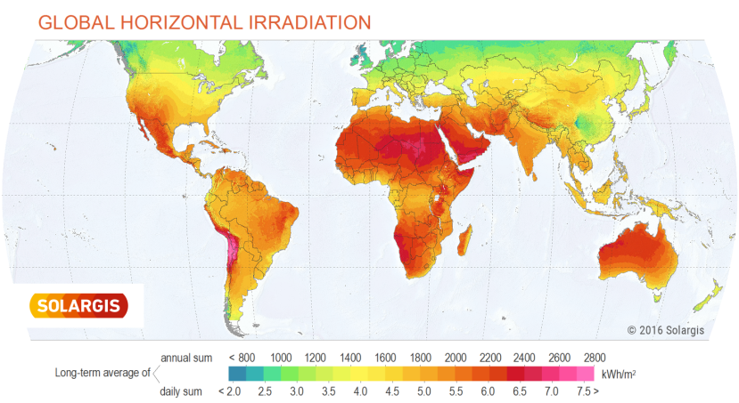

Why this application??
Company SolarGis
Gathering data of solar irradiation
Terrain work

Slide 4

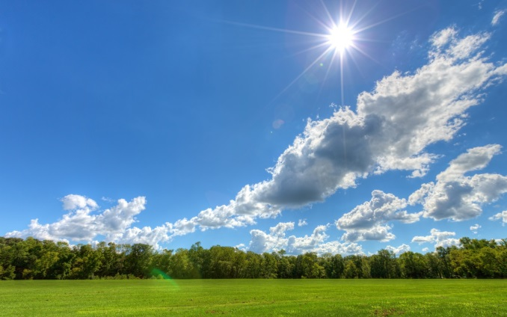
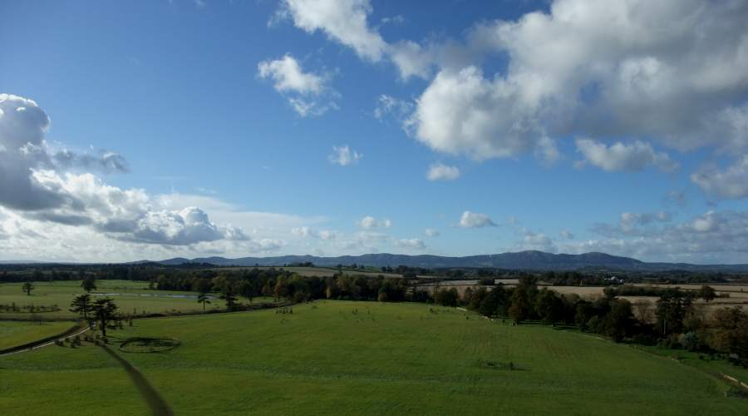
Why this application??
Make easier terrain work
Faster server computing
More comfortable

Slide 5


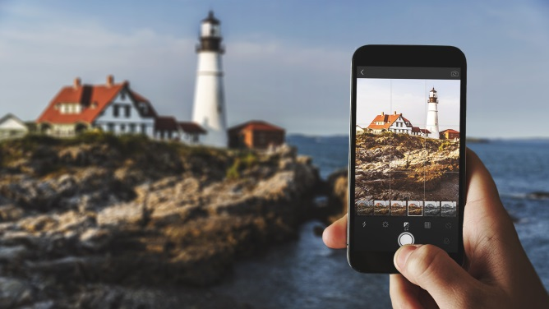
Functions of application
Like normal photo application
Take photo
Record videos
...

Slide 6

Functions of application
Special functions:
Save GPS + orientation of photos
Cut videos to photos
Take automatic panorama
...

Slide 7

Working process
Not implemented:
Notifications
Automatic data sending
The hardest:
Orientation sensors implementation
Think up appropriate variable names :D

Slide 8

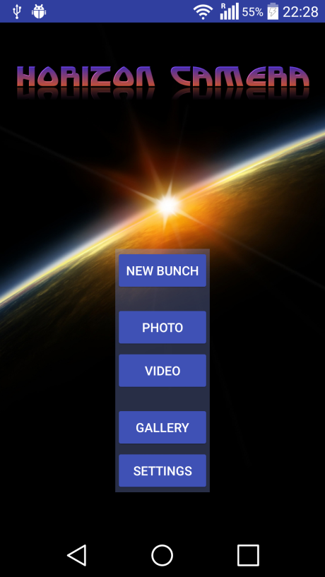
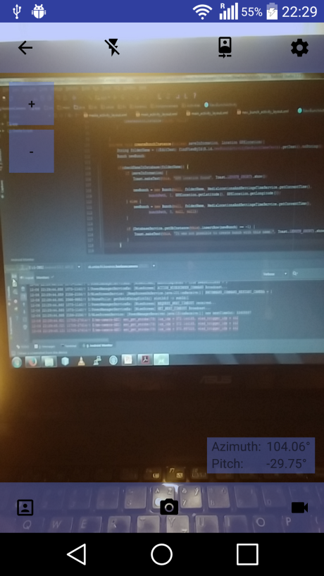
Demo

Slide 9
Thank you

